Slide 1


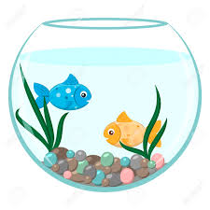
AUTO AQUA-THE SMART AQUATIC FEEDER- REVOLUTIONIZING FISH FEEDING
SUPERVISOR
SAYEDA AJBINA NUSRAT
Lecturer, Department of CSE, UITS
PRESENTED BY
AFIA ANJUM ID- 2014751124
ZINIA BINTE JAMAL ID- 2014751131
FARJANA SULTANA RAFI ID-2014751143

Slide 2
AGENDA
Introduction
Related Work
Problem Statement
Contribution
Experiment
Proposed Method
Result
Conclusion

Slide 3
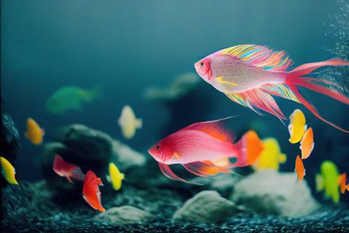
INTRODUCTION
Automates fish feeding in aquariums and
aquaculture.
Uses sensors, timers, and connectivity.
Scheduled feedings for routine maintenance.

Slide 4
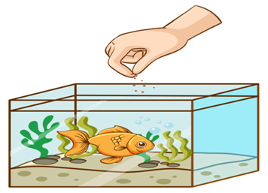
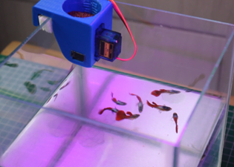
Why we need smart fish feeder?
Timely feeding, supporting fish health.
Preventing overfeeding and water pollution.
Allows scheduled feeding even when owners are absent.
Regular feeding routines reduce fish stress.
Hand feeding
Automatic feeding

Slide 5
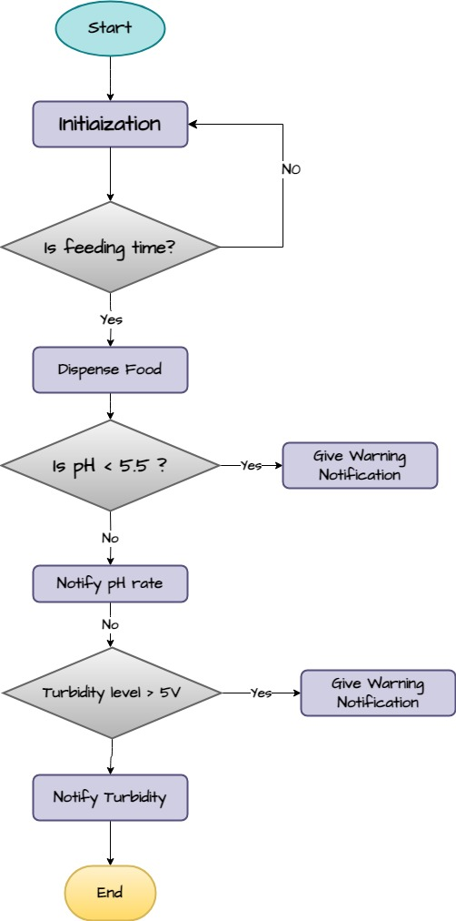
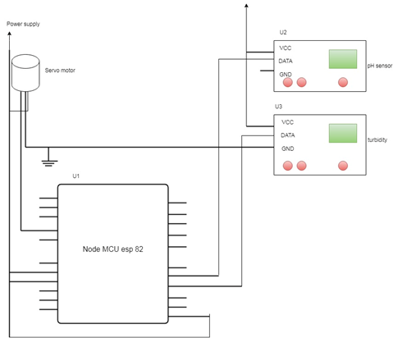
LITERATURE REVIEW
Related work 1
Fig-1: propose feeder system Circuit diagram.
[Reference: Design and Development of Microcontroller Based Automatic Fish Feeder System
ISSN 2321 3361 © 2020 IJESC Volume 10 Issue No.4 , Article · May 2020]
Fig-2: Flow-chart of automatic
fish feeder system
https://www.researchgate.net/publication/341113071_Design_and_Development_of_Microcontroller_Based_Automatic_Fish_Feeder_System

Slide 6
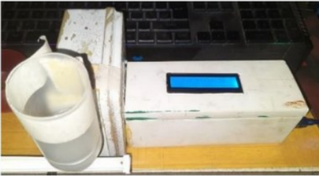
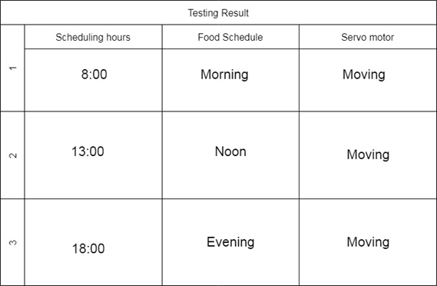
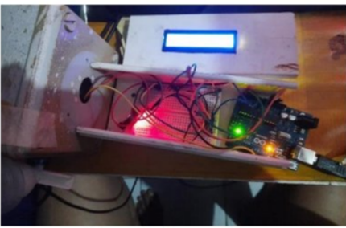
Related work 2
Scheduled feeding has been done.
No manual feeding system.
Fig-3: Power off
Fig-4:Power on
Table-1: Testing result of Scheduled feeding time.
[Reference: Paper2: Automatic fish feeders for fish farming in aquariums based on the Internet of Things (IOT). Jurnal Komputer dan Elektro Sains, Vol.1 No.1, Market 2023, ISSN Online xxxx-xxxx, DOI : https://doi.org/10.58291/komets.v1i1.98]
https://ejournal.sultanpublisher.com/index.php/komets/article/view/98/47

Slide 7
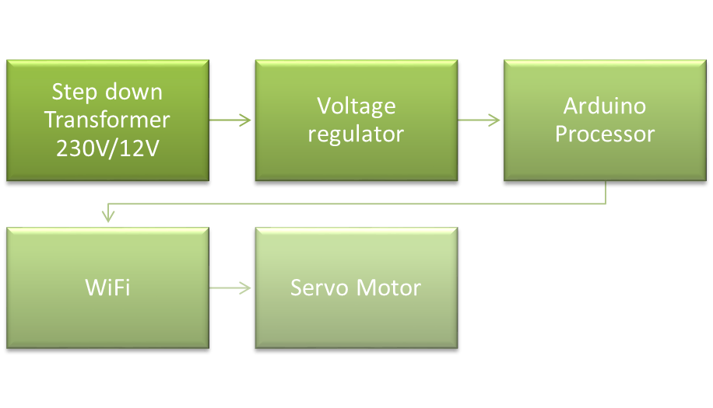
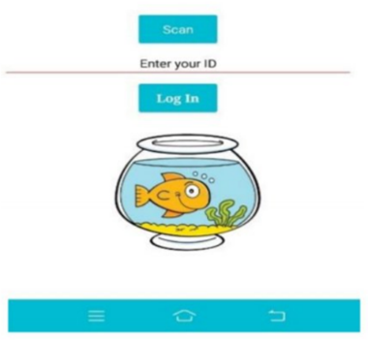
Related work 3
Used step down transformer to control the servo motor motion.
Used Scheduled feeding method.
Dispatch the food fish
Fig-4: Proposed system integrated with the MIT app interface login
Fig-5: Block diagram representing of the proposed system.
[Reference: IoT Based Fish Food Dispenser. 2023 9th International Conference on Advanced Computing and Communication Systems (ICACCS)]https://ieeexplore.ieee.org/abstract/document/10113051?fbclid=IwAR3b8VW1FK5X79lF04HagHNYoT-np_rQ0DXoCQIE5BqKnxQXGpek2TEesyY

Slide 8
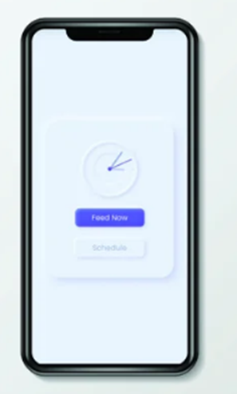
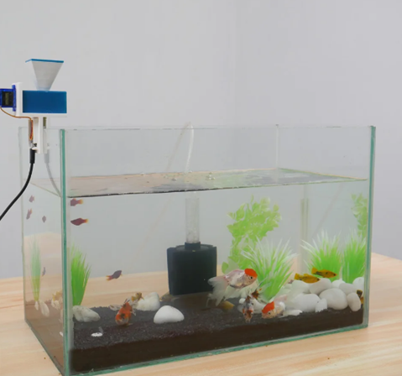
Related work 4
Firebase real-time data has been used.
Web-app has been used to control the feeding device.
Fig-6 Web-app
[Reference: Quasits : DIY Automatic Fish Feeder With Companion App By Coders Café Tech.]
nstructables.com/Aquassist-DIY-Automatic-Fish-Feeder-With-Companion/?fbclid=IwAR1mmOQoAbCm4XG6KUiGXt91s-23ZsoTo0hy5YBmvwoYMVeUCsMPpbfvJcc
fig-7: Automatic fish feeder using companion app.

Slide 9
PROBLEM STATEMENT
Paper 1
Unable to determine water temperature
Utilized an outdated Node MCU model(esp8266)
[Reference: Design and Development of Microcontroller Based Automatic Fish Feeder System
ISSN 2321 3361 © 2020 IJESC Volume 10 Issue No.4 , Article · May 2020]
Paper 2
Water purity and cloudiness cannot be measured.
Unable to determine water temperature & pH level.
No wireless connection from a remote place to the control system.
[Reference: Paper2: Automatic fish feeders for fish farming in aquariums based on the Internet of Things (IOT). Jurnal Komputer dan Elektro Sains, Vol.1 No.1, Market 2023, ISSN Online xxxx-xxxx, DOI : https://doi.org/10.58291/komets.v1i1.98]

Slide 10
Paper 3
Utilized a step-down transfer that wasn't necessary.
Can't quantify water filtration.
Absence of manual control.
[Reference: IoT Based Fish Food Dispenser. 2023 9th International Conference on Advanced Computing and Communication Systems (ICACCS)]
Paper 4
Firebase real-time dataset was utilized (difficult to establish).
Designed web app has been raise the cost.
No water quality sensor has ever been employed.
[Reference: Quasits : DIY Automatic Fish Feeder With Companion App By Coders Café Tech.]

Slide 11
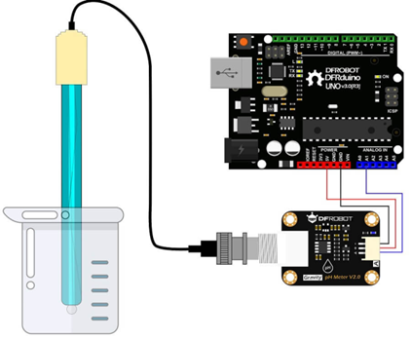
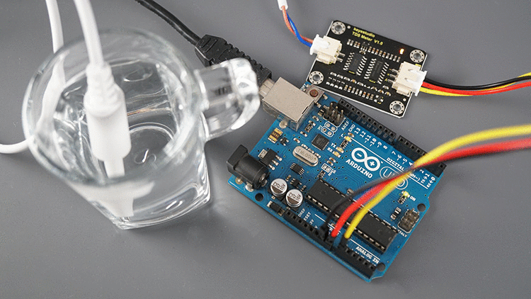
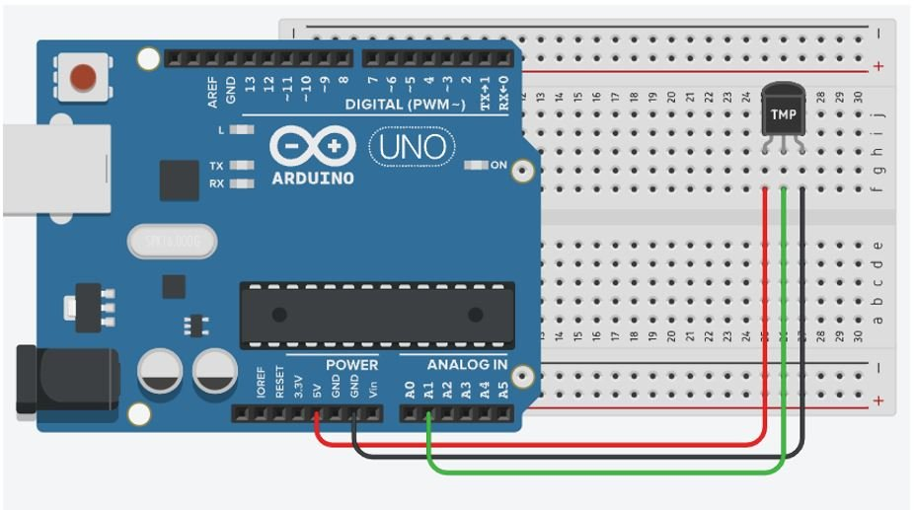
CONTRIBUTION
The fish morality rate is reduced by determine the correct water for fish using pH sensor and temperature sensor.
Water purity and cloudiness can be inspect by using turbidity sensor.
Use of build in app reduce the overall costing.
Using pH sensor
Using turbidity Sensor
Using temperature Sensor

Slide 12
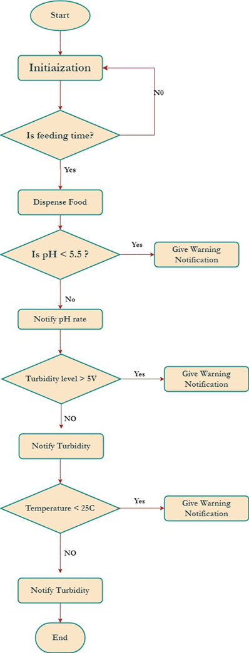
PROPOSED METHOD
About The automated system:
Designing compact, weather-resistant feeder with programmable control and storage.
Implementing adjustable feeding schedule for customization.
Exploring IoT integration for enhanced connectivity across aquaculture systems.
Fig-:8 Flowchart of proposed automated feeder system.

Slide 13
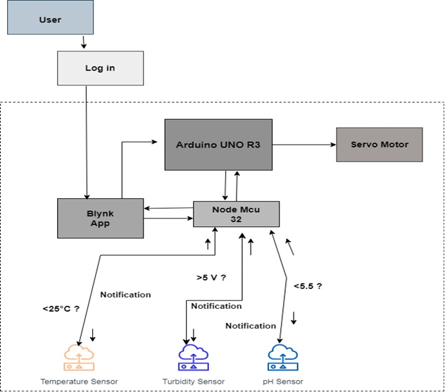
How to connect between hardware & software:
Sensors used as hardware & Blynk app used as software.
Sensors are connected to Node MCU esp32.
Node MCU in connected to Arduino UNO R3.
Arduino IDE connects NodeMCU with Blynk app through code implementation.
Fig-9: Block diagram of proposed system.

Slide 14
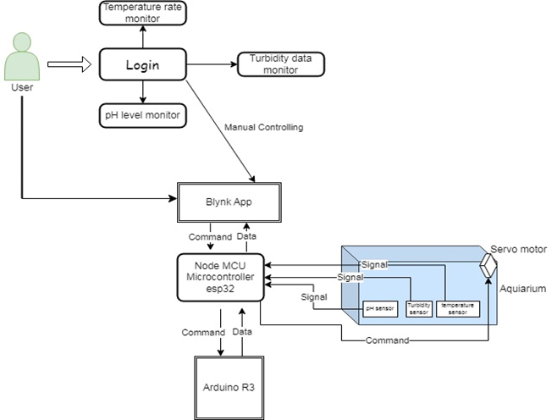
User friendly automated fish feeder system
Intuitive interface with clear scheduling options.
User will get notification for water condition
Control the feeding time both manually and scheduled.
Feed now
Fig-10: Use case diagram of automated fish feeding system.

Slide 15
Experiment
Hardware | Specification
ESP32 | CH340 - USB-C
Arduino | R3 SMD
Mini Servo | SG90
Breadboard | MB102
pH Sensor | PH0-14
Temperature Sensor | TMP36
Turbidity Sensor | DC5V
Jumper Wire | Male to Male & Male to Female
Software | Specification
Android and ioS | Blynk app

Slide 16
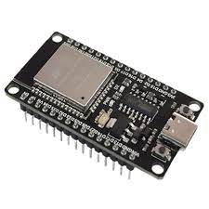
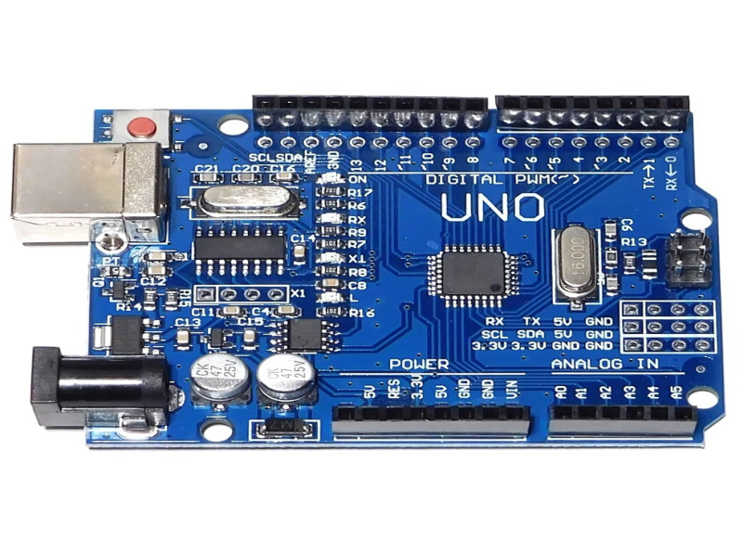
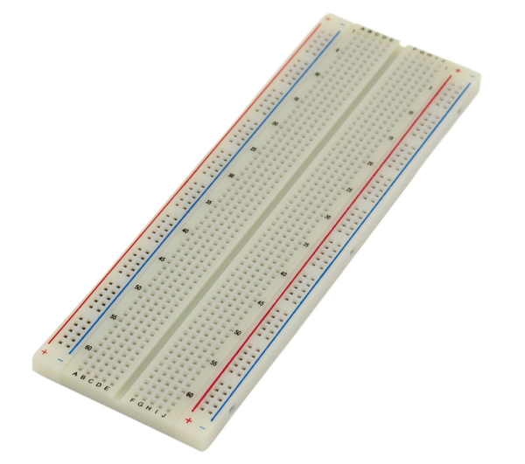
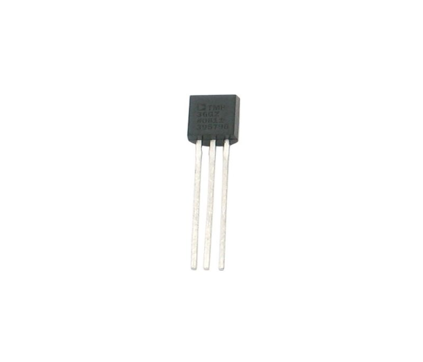
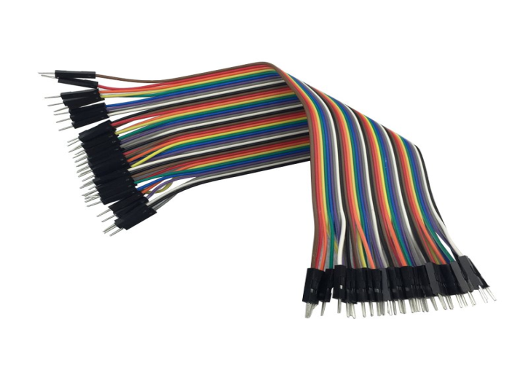
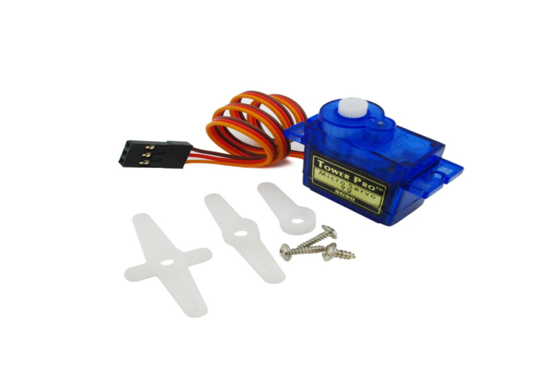
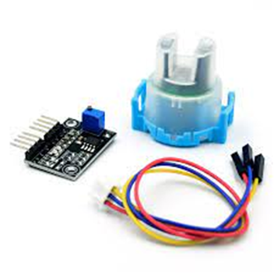
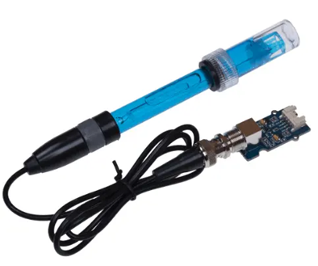
Hardware
Esp 32
Arduino
Breadboard
Temperature
Jumper Wire
pH Sensor
Turbidity Sensor
Servo Motor

Slide 17
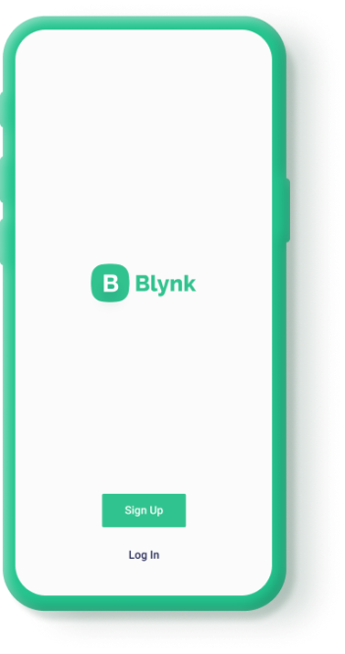


Software
Android
iOS
Blynk App

Slide 18
Conclusion
Smart fish feeding revolutionizes traditional aquaculture using technology for optimized practices.
Integration of technology with fisheries management enhances industry efficiency and sustainability.
Our efforts advance aquaculture, driving greater efficiency, sustainability, and prosperity.

Slide 20



